Slide 1
Operating Systems
Unit-I Introduction to Operating Systems

Slide 2
Operating Systems
Introduction to Operating Systems
An Operating System can be defined as an interface between user and hardware. It is responsible for the execution of all the processes, Resource Allocation, CPU management, File Management and many other tasks.
The purpose of an operating system is to provide an environment in which a user can execute programs in convenient and efficient manner.

Slide 3
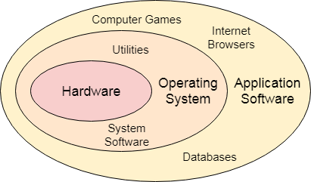
Operating Systems
Introduction to Operating Systems
In the Computer System (comprises of Hardware and software), Hardware can only understand machine code (in the form of 0 and 1) which doesn't make any sense to a naive user.
We need a system which can act as an intermediary and manage all the processes and resources present in the system.

Slide 4
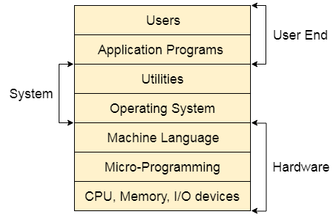
Operating Systems
Structure of a Computer System
A Computer System consists:
Users (people who are using the computer)
Application Programs (Compilers, Databases, Games, Video player, Browsers, etc.)
System Programs (Shells, Editors, Compilers, etc.)
Operating System ( A special program which acts as an interface between user and hardware )
Hardware ( CPU, Disks, Memory, etc)

Slide 5
Operating Systems
Types of Operating Systems (OS)
There are several types of Operating Systems which are mentioned below.
Batch Operating System
Multi-Programming System
Multi-Processing System
Multi-Tasking Operating System
Time-Sharing Operating System
Distributed Operating System
Network Operating System
Real-Time Operating System

Slide 6
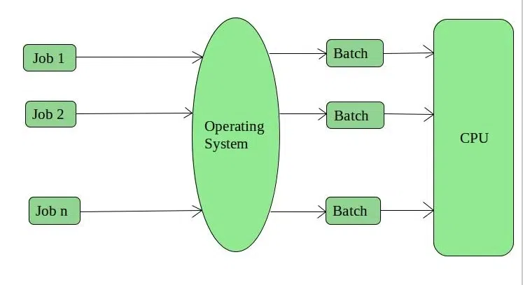
Operating Systems
Types of Operating Systems (OS)
1. Batch Operating System
This type of operating system does not interact with the computer directly. There is an operator which takes similar jobs having the same requirements and groups them into batches. It is the responsibility of the operator to sort jobs with similar needs. Batch Operating System is designed to manage and execute a large number of jobs efficiently by processing them in groups.
Batch Operating System

Slide 7
Operating Systems
Types of Operating Systems (OS)
1. Batch Operating System
This type of operating system does not interact with the computer directly. There is an operator which takes similar jobs having the same requirements and groups them into batches. It is the responsibility of the operator to sort jobs with similar needs. Batch Operating System is designed to manage and execute a large number of jobs efficiently by processing them in groups.
Batch Operating System

Slide 8
Operating Systems
Types of Operating Systems (OS)
Advantages of Batch Operating System
Multiple users can share the batch systems.
The idle time for the batch system is very less.
It is easy to manage large work repeatedly in batch systems.
Disadvantages of Batch Operating System
Batch systems are hard to debug.
It is sometimes costly.
The other jobs will have to wait for an unknown time if any job fails.
In batch operating system the processing time for jobs is commonly difficult to accurately predict while they are in the queue.
It is difficult to accurately predict the exact time required for a job to complete while it is in the queue.
Examples of Batch Operating Systems: Payroll Systems, Bank Statements, etc.

Slide 9
Operating Systems
Types of Operating Systems (OS)
2. Multi-Programming Operating System
Multiprogramming Operating Systems can be simply illustrated as more than one program is present in the main memory and any one of them can be kept in execution. This is basically used for better utilization of resources.
Advantages of Multi-Programming Operating System
Multi Programming increases the Throughput of the System.
It helps in reducing the response time.
Disadvantages of Multi-Programming Operating System
There is not any facility for user interaction of system resources with the system.

Slide 10
Operating Systems
Types of Operating Systems (OS)
3. Multi-Processing Operating System
Multi-Processing Operating System is a type of Operating System in which more than one CPU is used for the execution of resources. It betters the throughput of the System.
Advantages of Multi-Processing Operating System
It increases the throughput of the system.
As it has several processors, so, if one processor fails, we can proceed with another processor.
Disadvantages of Multi-Processing Operating System
Due to the multiple CPU, it can be more complex and somehow difficult to understand.

Slide 11
Operating Systems
Types of Operating Systems (OS)
4. Multi-Tasking Operating System
Multitasking Operating System is simply a multiprogramming Operating System with having facility of a Round-Robin Scheduling Algorithm. It can run multiple programs simultaneously.
There are two types of Multi-Tasking Systems which are listed below.
Preemptive Multi-Tasking
Cooperative Multi-Tasking
Advantages of Multi-Tasking Operating System
Multiple Programs can be executed simultaneously in Multi-Tasking Operating System.
It comes with proper memory management.
Disadvantages of Multi-Tasking Operating System
The system gets heated in case of heavy programs multiple times.

Slide 12
Operating Systems
Types of Operating Systems (OS)
5. Time-Sharing Operating Systems
Each task is given some time to execute so that all the tasks work smoothly. Each user gets the time of the CPU as they use a single system. These systems are also known as Multitasking Systems. The task can be from a single user or different users also. The time that each task gets to execute is called quantum. After this time interval is over OS switches over to the next task.
Advantages of Time-Sharing OS
Each task gets an equal opportunity.
Fewer chances of duplication of software.
CPU idle time can be reduced.
Resource Sharing: Time-sharing systems allow multiple users to share hardware resources such as the CPU, memory, and peripherals, reducing the cost of hardware and increasing efficiency.

Slide 13
Operating Systems
Types of Operating Systems (OS)
5. Time-Sharing Operating Systems
Advantages of Time-Sharing OS
Improved Productivity: Time-sharing allows users to work concurrently, thereby reducing the waiting time for their turn to use the computer. This increased productivity translates to more work getting done in less time.
Improved User Experience: Time-sharing provides an interactive environment that allows users to communicate with the computer in real time, providing a better user experience than batch processing.

Slide 14
Operating Systems
Types of Operating Systems (OS)
5. Time-Sharing Operating Systems
Disadvantages of Time-Sharing OS
Reliability problem.
One must have to take care of the security and integrity of user programs and data.
Data communication problem.
High Overhead: Time-sharing systems have a higher overhead than other operating systems due to the need for scheduling, context switching, and other overheads that come with supporting multiple users.
Complexity: Time-sharing systems are complex and require advanced software to manage multiple users simultaneously. This complexity increases the chance of bugs and errors.
Security Risks: With multiple users sharing resources, the risk of security breaches increases. Time-sharing systems require careful management of user access, authentication, and authorization to ensure the security of data and software.

Slide 15
Operating Systems
Types of Operating Systems (OS)
5. Time-Sharing Operating Systems
Examples of Time-Sharing OS with explanation
IBM VM/CMS : IBM VM/CMS is a time-sharing operating system that was first introduced in 1972. It is still in use today, providing a virtual machine environment that allows multiple users to run their own instances of operating systems and applications.
TSO (Time Sharing Option) : TSO is a time-sharing operating system that was first introduced in the 1960s by IBM for the IBM System/360 mainframe computer. It allowed multiple users to access the same computer simultaneously, running their own applications.
Windows Terminal Services : Windows Terminal Services is a time-sharing operating system that allows multiple users to access a Windows server remotely. Users can run their own applications and access shared resources, such as printers and network storage, in real-time.

Slide 16
Operating Systems
Types of Operating Systems (OS)
6. Distributed Operating System
These types of operating system is a recent advancement in the world of computer technology and are being widely accepted all over the world and, that too, at a great pace. Various autonomous interconnected computers communicate with each other using a shared communication network. Independent systems possess their own memory unit and CPU. These are referred to as loosely coupled systems or distributed systems . These systems’ processors differ in size and function. The major benefit of working with these types of the operating system is that it is always possible that one user can access the files or software which are not actually present on his system but some other system connected within this network i.e., remote access is enabled within the devices connected in that network.

Slide 17
Operating Systems
Types of Operating Systems (OS)
6. Distributed Operating System
Advantages of Distributed Operating System
Failure of one will not affect the other network communication, as all systems are independent of each other.
Electronic mail increases the data exchange speed.
Since resources are being shared, computation is highly fast and durable.
Load on host computer reduces.
These systems are easily scalable as many systems can be easily added to the network.
Delay in data processing reduces.

Slide 18
Operating Systems
Types of Operating Systems (OS)
6. Distributed Operating System
Disadvantages of Distributed Operating System
Failure of the main network will stop the entire communication.
To establish distributed systems the language is used not well-defined yet.
These types of systems are not readily available as they are very expensive. Not only that the underlying software is highly complex and not understood well yet.
Examples of Distributed Operating Systems are LOCUS, etc.

Slide 19
Operating Systems
Types of Operating Systems (OS)
6. Distributed Operating System
Issues With Distributed Operating Systems
Networking causes delays in the transfer of data between nodes of a distributed system. Such delays may lead to an inconsistent view of data located in different nodes, and make it difficult to know the chronological order in which events occurred in the system.
Control functions like scheduling, resource allocation, and deadlock detection have to be performed in several nodes to achieve computation speedup and provide reliable operation when computers or networking components fail.
Messages exchanged by processes present in different nodes may travel over public networks and pass through computer systems that are not controlled by the distributed operating system. An intruder may exploit this feature to tamper with messages, or create fake messages to fool the authentication procedure and masquerade as a user of the system

Slide 20
Operating Systems
Types of Operating Systems (OS)
7. Network Operating System
These systems run on a server and provide the capability to manage data, users, groups, security, applications, and other networking functions. These types of operating systems allow shared access to files, printers, security, applications, and other networking functions over a small private network. One more important aspect of Network Operating Systems is that all the users are well aware of the underlying configuration, of all other users within the network, their individual connections, etc. and that’s why these computers are popularly known as tightly coupled systems .
Advantages of Network Operating System
Highly stable centralized servers.
Security concerns are handled through servers.
New technologies and hardware up-gradation are easily integrated into the system.
Server access is possible remotely from different locations and types of systems.

Slide 21
Operating Systems
Types of Operating Systems (OS)
7. Network Operating System
Disadvantages of Network Operating System
Servers are costly.
User has to depend on a central location for most operations.
Maintenance and updates are required regularly.
Examples of Network Operating Systems are Microsoft Windows Server 2003, Microsoft Windows Server 2008, UNIX, Linux, Mac OS X, Novell NetWare, BSD, etc.

Slide 22
Operating Systems
Types of Operating Systems (OS)
8. Real-Time Operating System
These types of OSs serve real-time systems. The time interval required to process and respond to inputs is very small. This time interval is called response time. Real-time systems are used when there are time requirements that are very strict like missile systems, air traffic control systems, robots, etc.
Types of Real-Time Operating Systems
Hard Real-Time Systems: Hard Real-Time OSs are meant for applications where time constraints are very strict and even the shortest possible delay is not acceptable. These systems are built for saving life like automatic parachutes or airbags which are required to be readily available in case of an accident. Virtual memory is rarely found in these systems.
Soft Real-Time Systems: These OSs are for applications where time-constraint is less strict.

Slide 23
Operating Systems
Types of Operating Systems (OS)
8. Real-Time Operating System
Advantages of RTOS
Maximum Consumption: Maximum utilization of devices and systems, thus more output from all the resources.
Task Shifting: The time assigned for shifting tasks in these systems is very less. For example, in older systems, it takes about 10 microseconds in shifting from one task to another, and in the latest systems, it takes 3 microseconds.
Focus on Application: Focus on running applications and less importance on applications that are in the queue.
Real-time operating system in the embedded system: Since the size of programs is small, RTOS can also be used in embedded systems like in transport and others.
Error Free: These types of systems are error-free.
Memory Allocation: Memory allocation is best managed in these types of systems.

Slide 24
Operating Systems
Operating System Generations
Generation of Operating System
Below are four generations of operating systems.
The First Generation
The Second Generation
The Third Generation
The Fourth Generation
1. The First Generation (1940 to early 1950s)
In 1940, an operating system was not included in the creation of the first electrical computer. Early computer users had complete control over the device and wrote programs in pure machine language for every task. During the computer generation, a programmer can merely execute and solve basic mathematical calculations. an operating system is not needed for these computations.

Slide 25
Operating Systems
Operating System Generations
Generation of Operating System
2. The Second Generation (1955 – 1965)
GMOSIS, the first operating system (OS) was developed in the early 1950s. For the IBM Computer, General Motors has created the operating system. Because it gathers all related jobs into groups or batches and then submits them to the operating system using a punch card to finish all of them, the second-generation operating system was built on a single-stream batch processing system.

Slide 26
Operating Systems
Operating System Generations
Generation of Operating System
3. The Third Generation (1965 – 1980)
Because it gathers all similar jobs into groups or batches and then submits them to the second generation operating system using a punch card to finish all jobs in a machine, the second-generation operating system was based on a single stream batch processing system. Control is transferred to the operating system upon each job’s completion, whether it be routinely or unexpectedly. The operating system cleans up after each work is finished before reading and starting the subsequent job on a punch card. Large, professionally operated machines known as mainframes were introduced after that. Operating system designers were able to create a new operating system in the late 1960s that was capable of multiprogramming—the simultaneous execution of several tasks in a single computer program.
In order to create operating systems that enable a CPU to be active at all times by carrying out multiple jobs on a computer at once, multiprogramming has to be introduced. With the release of the DEC PDP-1 in 1961, the third generation of minicomputers saw a new phase of growth and development

Slide 27
Operating Systems
Operating System Generations
Generation of Operating System
4. The Fourth Generation (1980 – Present Day)
The fourth generation of personal computers is the result of these PDPs. The Generation IV (1980–Present)The evolution of the personal computer is linked to the fourth generation of operating systems. Nonetheless, the third-generation minicomputers and the personal computer have many similarities. At that time, minicomputers were only slightly more expensive than personal computers, which were highly expensive.

Slide 28
Operating Systems
Operating System Generations
Generation of Operating System
4. The Fourth Generation (1980 – Present Day)
The development of Microsoft and the Windows operating system was a significant influence in the creation of personal computers. In 1975, Microsoft developed the first Windows operating system. Bill Gates and Paul Allen had the idea to advance personal computers after releasing the Microsoft Windows OS. As a result, the MS-DOS was released in 1981, but users found it extremely challenging to decipher its complex commands. Windows is now the most widely used and well-liked operating system available. Following then, Windows released a number of operating systems, including Windows 95, Windows 98, Windows XP, and Windows 7, the most recent operating system. The majority of Windows users are currently running Windows 10. Apple is another well-known operating system in addition to Windows.

Slide 29
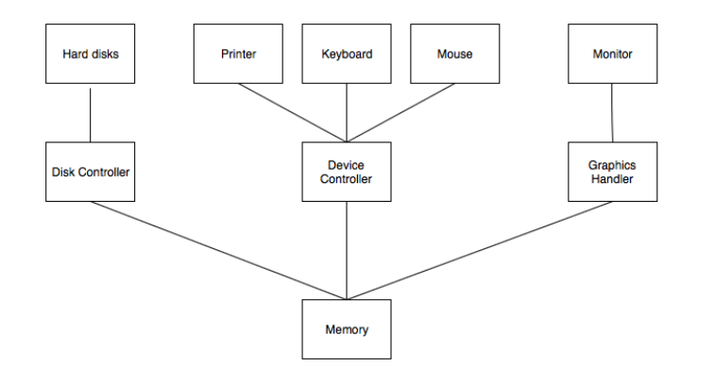
Operating Systems
Computer System Organisation
The computer system is a combination of many parts such as peripheral devices, secondary memory, CPU, etc. This can be explained more clearly using a diagram..

Slide 30
Operating Systems
Computer System Organisation
The I/O devices and the CPU both execute concurrently. Some of the processes are scheduled for the CPU and at the same time, some are undergoing input/output operations.
There are multiple device controllers, each in charge of a particular device such as keyboard, mouse, printer etc.
There is buffer available for each of the devices. The input and output data can be stored in these buffers.
The data is moved from memory to the respective device buffers by the CPU for I/O operations and then this data is moved back from the buffers to memory.
The device controllers use an interrupt to inform the CPU that I/O operation is completed.

Slide 31
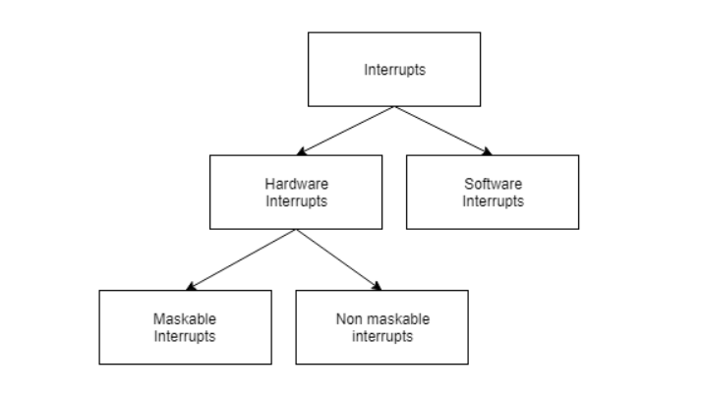
Operating Systems
Computer System Organisation
Interrupt Handling
An interrupt is a necessary part of Computer System Organisation as it is triggered by hardware and software parts when they need immediate attention.
An interrupt can be generated by a device or a program to inform the operating system to halt its current activities and focus on something else. The types of interrupts are better explained using the following diagram −

Slide 32
Operating Systems
Computer System Organisation
Interrupt Handling
An interrupt is a necessary part of Computer System Organisation as it is triggered by hardware and software parts when they need immediate attention.
An interrupt can be generated by a device or a program to inform the operating system to halt its current activities and focus on something else. The types of interrupts are better explained using the following diagram −

Slide 33
Operating Systems
Computer System Organisation
Interrupt Handling
Hardware and software interrupts are two types of interrupts. Hardware interrupts are triggered by hardware peripherals while software interrupts are triggered by software function calls.
Hardware interrupts are of further two types. Maskable interrupts can be ignored or disabled by the CPU while this is not possible for non maskable interrupts.

Slide 34
Operating Systems
Computer System Organisation
Interrupt Handling
Hardware and software interrupts are two types of interrupts. Hardware interrupts are triggered by hardware peripherals while software interrupts are triggered by software function calls.
Hardware interrupts are of further two types. Maskable interrupts can be ignored or disabled by the CPU while this is not possible for non maskable interrupts.

Slide 35
Operating Systems
Computer Architecture VS Computer Organization
Computer Architecture | Computer Organization
Computer Architecture is concerned with the way hardware components are connected together to form a computer system. | Computer Organization is concerned with the structure and behaviour of a computer system as seen by the user.
It acts as the interface between hardware and software. | It deals with the components of a connection in a system.
Computer Architecture helps us to understand the functionalities of a system. | Computer Organization tells us how exactly all the units in the system are arranged and interconnected.
A programmer can view architecture in terms of instructions, addressing modes and registers. | Whereas Organization expresses the realization of architecture.
While designing a computer system architecture is considered first. | An organization is done on the basis of architecture.
Computer Architecture deals with high-level design issues. | Computer Organization deals with low-level design issues.
Architecture involves Logic (Instruction sets, Addressing modes, Data types, Cache optimization) | Organization involves Physical Components (Circuit design, Adders, Signals, Peripherals)

Slide 36
Operating Systems
Design and Implementation in Operating System
Design Goals:
Design goals are the objectives of the operating system. They must be met to fulfill design requirements and they can be used to evaluate the design. These goals may not always be technical, but they often have a direct impact on how users perceive their experience with an operating system. While designers need to identify all design goals and prioritize them, they also need to ensure that these goals are compatible with each other as well as compatible with user expectations or expert advice.
Designers also need to identify all possible ways in which their designs could conflict with other parts of their systems—and then prioritize those potential conflicts based on cost-benefit analysis (CBA). This process allows for better decision-making about what features make sense for inclusion into final products versus those which would require extensive rework later down the road. It’s also important to note that CBA is not just about financial costs; it can also include other factors like user experience, time to market, and the impact on other systems.

Slide 37
Operating Systems
Design and Implementation in Operating System
Design Goals:
The process of identifying design goals, conflicts, and priorities is often referred to as “goal-driven design.” The goal of this approach is to ensure that each design decision is made with the best interest of users and other stakeholders in mind.

Slide 38
Operating Systems
Design and Implementation in Operating System
Mechanisms and Policies:
An operating system is a set of software components that manage a computer’s resources and provide overall system management.
Mechanisms and policies are the two main components of an operating system. Mechanisms handle low-level functions such as scheduling, memory management, and interrupt handling; policies handle higher-level functions such as resource management, security, and reliability. A well-designed OS should provide both mechanisms and policies for each component in order for it to be successful at its task:

Slide 39
Operating Systems
Design and Implementation in Operating System
Mechanisms and Policies:
Mechanisms should ensure that applications have access to appropriate hardware resources (seats). They should also make sure that applications don’t interfere with each other’s use of these resources (for example through mutual exclusion).
Policies determine how processes will interact with one another when they’re running simultaneously on multiple CPUs within a single machine instance – what processor affinity should occur during multitasking operations? Should all processes be allowed access simultaneously or just those belonging specifically within group ‘A’?’

Slide 40
Operating Systems
Design and Implementation in Operating System
Implementation:
Implementation is the process of writing source code in a high-level programming language, compiling it into object code, and then interpreting (executing) this object code by means of an interpreter. The purpose of an operating system is to provide services to users while they run applications on their computers.
The main function of an operating system is to control the execution of programs. It also provides services such as memory management, interrupt handling, and file system access facilities so that programs can be better utilized by users or other devices attached to the system.

Slide 41
Operating Systems
Design and Implementation in Operating System
Implementation:
An operating system is a program or software that controls the computer’s hardware and resources. It acts as an intermediary between applications, users, and the computer’s hardware. It manages the activities of all programs running on a computer without any user intervention.
The operating system performs many functions such as managing the computer’s memory, enforcing security policies, and controlling peripheral devices. It also provides a user interface that allows users to interact with their computers.

Slide 42
Operating Systems
Design and Implementation in Operating System
Implementation:
The operating system is typically stored in ROM or flash memory so it can be run when the computer is turned on. The first operating systems were designed to control mainframe computers. They were very large and complex, consisting of millions of lines of code and requiring several people to develop them.

Slide 43
Operating Systems
Design and Implementation in Operating System
Implementation:
Today, operating systems are much smaller and easier to use. They have been designed to be modular so they can be customized by users or developers.
There are many different types of operating systems:
Graphical user interfaces (GUIs) like Microsoft Windows and Mac OS.
Command line interfaces like Linux or UNIX
Real-time operating systems that control industrial and scientific equipment
Embedded operating systems are designed to run on a single computer system without needing an external display or keyboard.

Slide 44
Operating Systems
Operating System Operations
Operating System Operations
Operating system operations refer to the tasks and processes that an operating system performs to manage hardware resources and provide a platform for software applications to run on. These operations include managing memory, controlling input and output devices, handling user input, providing a user interface, managing security, and facilitating software application communication with hardware devices.

Slide 45
Operating Systems
Operating System Operations
Operating System Operations
File Management:
A file is a named collection of related data that is stored on a storage device such as a hard disk or flash drive. The operating system provides a file system that manages the creation, deletion, and manipulation of files. It provides a way for applications to access and modify the data stored in files.

Slide 46
Operating Systems
Operating System Operations
Operating System Operations
Device Management:
A device in an operating system refers to any physical or virtual component that is used to interact with the system. The operating system provides device drivers, which are software components that enable the system to communicate with different devices and manage their input/output operations.

Slide 47
Operating Systems
Operating System Operations
Operating System Operations
Memory Management:
The operating system manages the allocation of memory to running processes and ensures that they do not interfere with each other’s memory usage. Memory is typically divided into two types: physical memory RAM and virtual memory, which uses hard disk space to simulate additional RAM.

Slide 48
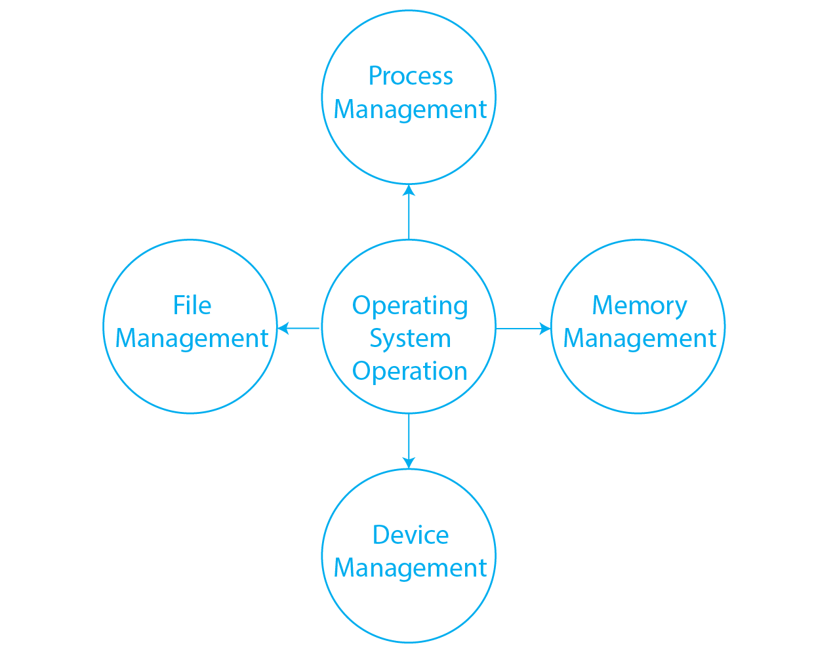
Operating Systems
Operating System Operations
Operating System Operations
Process Management: A process has its own memory space, CPU time, and other system resources allocated to it by the operating system. The operating system schedules process on the CPU manages their memory usage and provides inter-process communication mechanisms that allow processes to communicate and synchronize with each other.

Slide 49
Operating Systems
System Protection in Operating System
System protection in an operating system refers to the mechanisms implemented by the operating system to ensure the security and integrity of the system. System protection involves various techniques to prevent unauthorized access, misuse, or modification of the operating system and its resources.
There are several ways in which an operating system can provide system protection:

Slide 50
Operating Systems
System Protection in Operating System
System protection:
User authentication: The operating system requires users to authenticate themselves before accessing the system. Usernames and passwords are commonly used for this purpose.
Access control: The operating system uses access control lists (ACLs) to determine which users or processes have permission to access specific resources or perform specific actions.
Encryption: The operating system can use encryption to protect sensitive data and prevent unauthorized access.

Slide 51
Operating Systems
System Protection in Operating System
Firewall: A firewall is a software program that monitors and controls incoming and outgoing network traffic based on predefined security rules.
Antivirus software: Antivirus software is used to protect the system from viruses, malware, and other malicious software.
System updates and patches: The operating system must be kept up-to-date with the latest security patches and updates to prevent known vulnerabilities from being exploited.
By implementing these protection mechanisms, the operating system can prevent unauthorized access to the system, protect sensitive data, and ensure the overall security and integrity of the system.

Slide 52
Operating Systems
System Protection in Operating System
Need for Protection:
To prevent the access of unauthorized users
To ensure that each active programs or processes in the system uses resources only as the stated policy
To improve reliability by detecting latent errors

Slide 53
Operating Systems
System Protection in Operating System
Advantages of system protection in an operating system:
Ensures the security and integrity of the system
Prevents unauthorized access, misuse, or modification of the operating system and its resources
Protects sensitive data
Provides a secure environment for users and applications
Prevents malware and other security threats from infecting the system
Allows for safe sharing of resources and data among users and applications
Helps maintain compliance with security regulations and standards

Slide 54
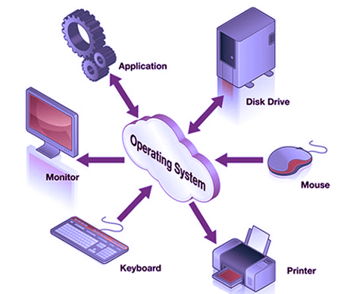
Operating Systems
Operating System Services
Operating System Services:
An operating system is software that acts as an intermediary between the user and computer hardware. It is a program with the help of which we are able to run various applications. It is the one program that is running all the time. Every computer must have an operating system to smoothly execute other programs.

Slide 55
Operating Systems
Operating System Services
Operating System Services:
Program Execution
It is the Operating System that manages how a program is going to be executed. It loads the program into the memory after which it is executed. The order in which they are executed depends on the CPU Scheduling Algorithms. A few are FCFS, SJF, etc. When the program is in execution, the Operating System also handles deadlock i.e. no two processes come for execution at the same time. The Operating System is responsible for the smooth execution of both user and system programs. The Operating System utilizes various resources available for the efficient running of all types of functionalities.

Slide 56
Operating Systems
Operating System Services
Operating System Services:
Input Output Operations
Operating System manages the input-output operations and establishes communication between the user and device drivers. Device drivers are software that is associated with hardware that is being managed by the OS so that the sync between the devices works properly. It also provides access to input-output devices to a program when needed.

Slide 57
Operating Systems
Operating System Services
Operating System Services:
Communication Between Processes
The Operating system manages the communication between processes. Communication between processes includes data transfer among them. If the processes are not on the same computer but connected through a computer network, then also their communication is managed by the Operating System itself.

Slide 58
Operating Systems
Operating System Services
Operating System Services:
File Management
The operating system helps in managing files also. If a program needs access to a file, it is the operating system that grants access. These permissions include read-only, read-write, etc. It also provides a platform for the user to create, and delete files. The Operating System is responsible for making decisions regarding the storage of all types of data or files, i.e, floppy disk/hard disk/pen drive, etc. The Operating System decides how the data should be manipulated and stored.

Slide 59
Operating Systems
Operating System Services
Operating System Services:
Memory Management
Let’s understand memory management by OS in simple way. Imagine a cricket team with limited number of player . The team manager (OS) decide whether the upcoming player will be in playing 11 ,playing 15 or will not be included in team , based on his performance . In the same way, OS first check whether the upcoming program fulfil all requirement to get memory space or not ,if all things good, it checks how much memory space will be sufficient for program and then load the program into memory at certain location. And thus , it prevents program from using unnecessary memory.

Slide 60
Operating Systems
Operating System Services
Operating System Services:
Process Management
Let’s understand the process management in unique way. Imagine, our kitchen stove as the (CPU) where all cooking(execution) is really happen and chef as the (OS) who uses kitchen-stove(CPU) to cook different dishes(program). The chef(OS) has to cook different dishes(programs) so he ensure that any particular dish(program) does not take long time(unnecessary time) and all dishes(programs) gets a chance to cooked(execution) .The chef(OS) basically scheduled time for all dishes(programs) to run kitchen(all the system) smoothly and thus cooked(execute) all the different dishes(programs) efficiently.

Slide 61
Operating Systems
Operating System Services
Operating System Services:
Security and Privacy
Security : OS keep our computer safe from an unauthorized user by adding security layer to it. Basically, Security is nothing but just a layer of protection which protect computer from bad guys like viruses and hackers. OS provide us defenses like firewalls and anti-virus software and ensure good safety of computer and personal information.
Privacy : OS give us facility to keep our essential information hidden like having a lock on our door, where only you can enter and other are not allowed . Basically , it respect our secrets and provide us facility to keep it safe.

Slide 62
Operating Systems
Operating System Services
Operating System Services:
Resource Management
System resources are shared between various processes. It is the Operating system that manages resource sharing. It also manages the CPU time among processes using CPU Scheduling Algorithms. It also helps in the memory management of the system. It also controls input-output devices. The OS also ensures the proper use of all the resources available by deciding which resource to be used by whom.

Slide 63
Operating Systems
Operating System Services
Operating System Services:
Resource Management
User Interface
User interface is essential and all operating systems provide it. Users either interacts with the operating system through the command-line interface or graphical user interface or GUI. The command interpreter executes the next user-specified command.
A GUI offers the user a mouse-based window and menu system as an interface.

Slide 64
Operating Systems
Operating System Services
Operating System Services:
Networking
This service enables communication between devices on a network, such as connecting to the internet, sending and receiving data packets, and managing network connections.
Error Handling
The Operating System also handles the error occurring in the CPU, in Input-Output devices, etc. It also ensures that an error does not occur frequently and fixes the errors. It also prevents the process from coming to a deadlock. It also looks for any type of error or bugs that can occur while any task. The well-secured OS sometimes also acts as a countermeasure for preventing any sort of breach of the Computer System from any external source and probably handling them.

Slide 65
Operating Systems
Operating System Services
Operating System Services:
Time Management
Imagine traffic light as (OS), which indicates all the cars(programs) whether it should be stop(red)=>(simple queue), start(yellow)=>(ready queue),move(green)=>(under execution) and this light (control) changes after a certain interval of time at each side of the road(computer system) so that the cars(program) from all side of road move smoothly without traffic.

Slide 66
Keep Learning
Thank You!

